Slide 1

Cyber Attack Simulations in PowerShell
Understanding and Detecting Malicious Activities
Presented by: Shaikh Sadik Rahman(12231823 ParbhuRam Khadka(12268198), Sanjaya Poudel (12240769) Course: Cyber Security Technologies

Slide 2
Introduction
Presented in this paper is understanding and utilization of PowerShell scripts in simulating cyber attacks.
They underscore the need for learning attack strategies to improve security strength.
More actual cyber attacks have been reported in the recent past and therefore hands on experience is important.

Slide 3
Creating a Suspicious Shortcut File
Description: This attack imitates that of creating a symbolic link that stands for an executable file.(Anyam, 2024).
Purpose: The entry shows how attackers can mask malevolent software using shortcuts.

Slide 4
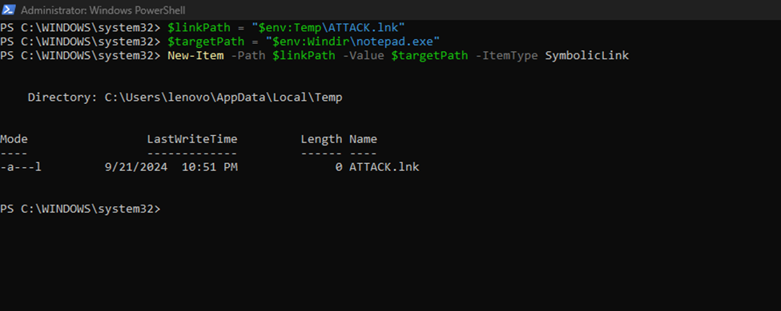
Step 1 - Create a Symbolic Link
Explanation: Creates a shortcut file (ATTACK.lnk) that links notepad.exe, thus mimicking a threat file.
It explains how attackers are capable of inventing misleading shortcuts.

Slide 5
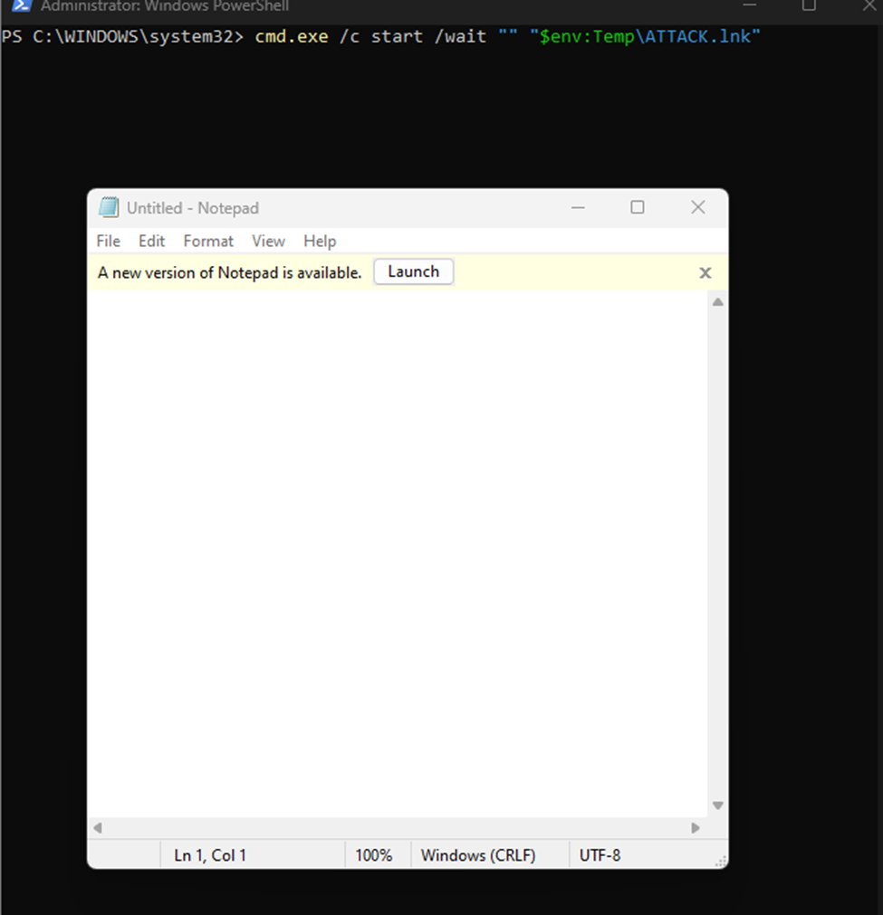
Run the Link
Explanation: Executes the symbolic link, mimicking how an attacker would run malware.
In a real attack, this would execute a harmful payload disguised as a legitimate program.

Slide 6
Creating a Hidden Scheduled Task
Description: This attack simulates the creation of a scheduled task to maintain persistence.
Attackers often use scheduled tasks to ensure their malicious software runs at startup.
Purpose: Demonstrates how attackers can execute malware at system startup(Poudel, 2024).

Slide 7
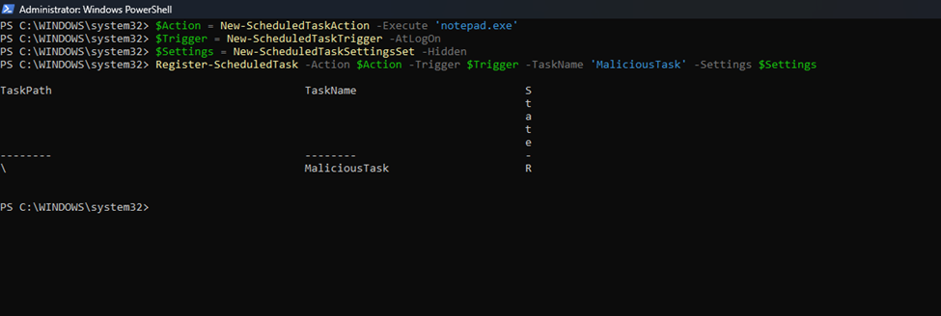
Create a Scheduled Task
Created a hidden task that runs notepad.exe at login, emulating malware behavior.
In practice, this task would launch malicious software instead of a harmless application.

Slide 8
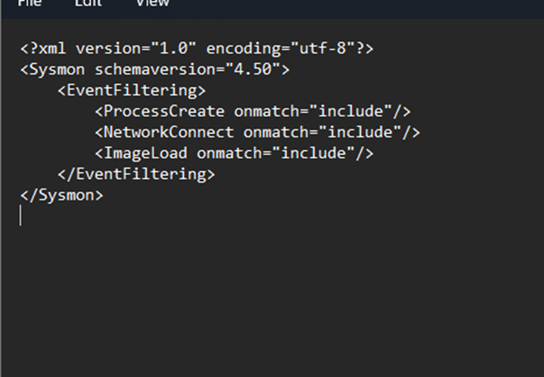
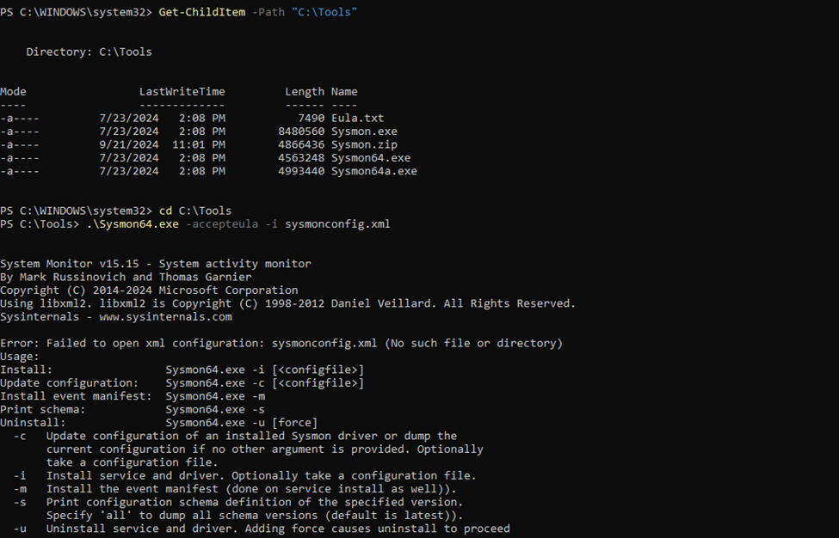
Detect the Attacks with Sysmon
Sysmon captures events related to file and process creation.
The configuration file specifies what events to monitor, such as file creation and process execution(Mark Russinovich, 2022).

Slide 9
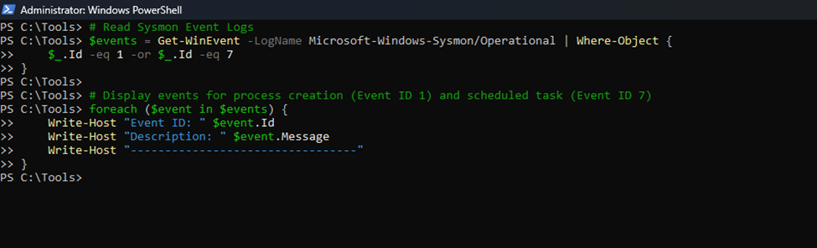
Analyze Sysmon Logs
Explanation: Filters Sysmon logs for events indicating process creation and scheduled task creation.
This script filters Sysmon logs for process creation (Event ID 1) and scheduled task creation (Event ID 7).
Analyzing these logs is critical for identifying potential malicious activity in the system(ManageEngine, 2019).

Slide 10

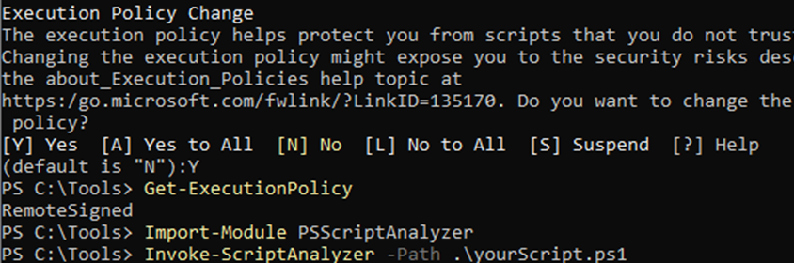
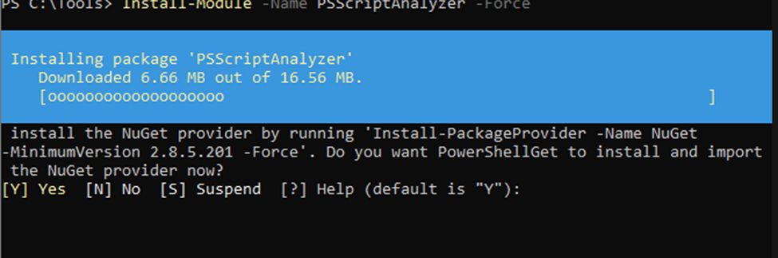
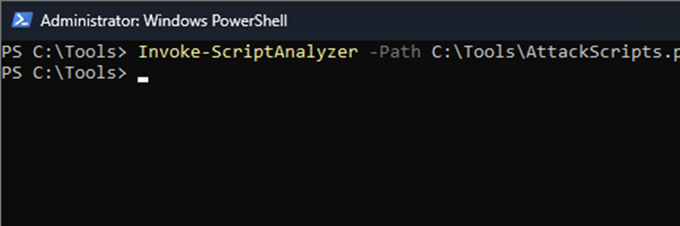
Clean Up Scripts
Explanation: Checks for best practices and potential issues in your PowerShell scripts.
Maintaining clean scripts is essential for reliable and safe automation in cybersecurity.

Slide 11
Conclusion
Successfully simulated attacks demonstrate how attackers operate.
Implications: Understanding these techniques is crucial for developing effective defenses against cyber threats and emphasize the importance of continuous learning and monitoring in cybersecurity.

Slide 12
References
Anyam, H. (2024, June 14). Hunting for suspicious Windows LNK files with Wazuh XDR. Wazuh. https://wazuh.com/blog/hunting-for-suspicious-windows-lnk-files-with-wazuh-xdr/
ManageEngine. (2019). Sysmon log analyzer | ManageEngine EventLog Analyzer. https://www.manageengine.com/products/eventlog/sysmon-logs-analysis.html
Mark Russinovich. (2022, January 5). Defrag Tools - Learn Sysinternals Sysmon with Mark Russinovich [Video]. YouTube. https://www.youtube.com/watch?v=zDPSHJwjGqM
Poudel, S. S. (2024, August 26). Shenanigans of scheduled tasks. Logpoint. https://www.logpoint.com/en/blog/shenanigans-of-scheduled-tasks/

Slide 13

Thankyou Please feel free to ask any questions or discuss further

